Slide 1



Field redefinitions and renormalization group equations in RχT
PSI, July 2nd 2009
J.J. Sanz-Cillero ( UAB – IFAE )
[arXiv:0905.3676 [hep-ph] ]

Slide 2
Outline
Formal 1/N_{C} expansion in RχT
The example of the ππ-VFF:
    One-loop computation
    EoM, Field redef. & redundant operators
    RGE → Solutions → IR-fixed point
    Perturbative regime →Perturbation theory in 1/N_{C}

Slide 3
1/N_{C} expansion
in RχT
Notes:
3

Slide 4
RχT = chiral invariant framework
  for the interaction of chiral NGB & Resonances
The standard EFT expansion in powers of (p²)^{m} ,
not valid in presence of heavy resonance loops
→An alternative power counting is required
➔RχT takes the formal 1/N_{C} expansion as a guiding principle:
- N_{C} scaling of the operators in L at LO in 1/N_{C}:
L= … + λ O , with k meson fields → scales like N_{C}^{1-k/2}
- Subleading operators→ subleading scaling in 1/N_{C}
(with respect to the latter)
[Ecker et al.’89]
[‘t Hooft’74, 75]
[Witten’79]

Slide 5
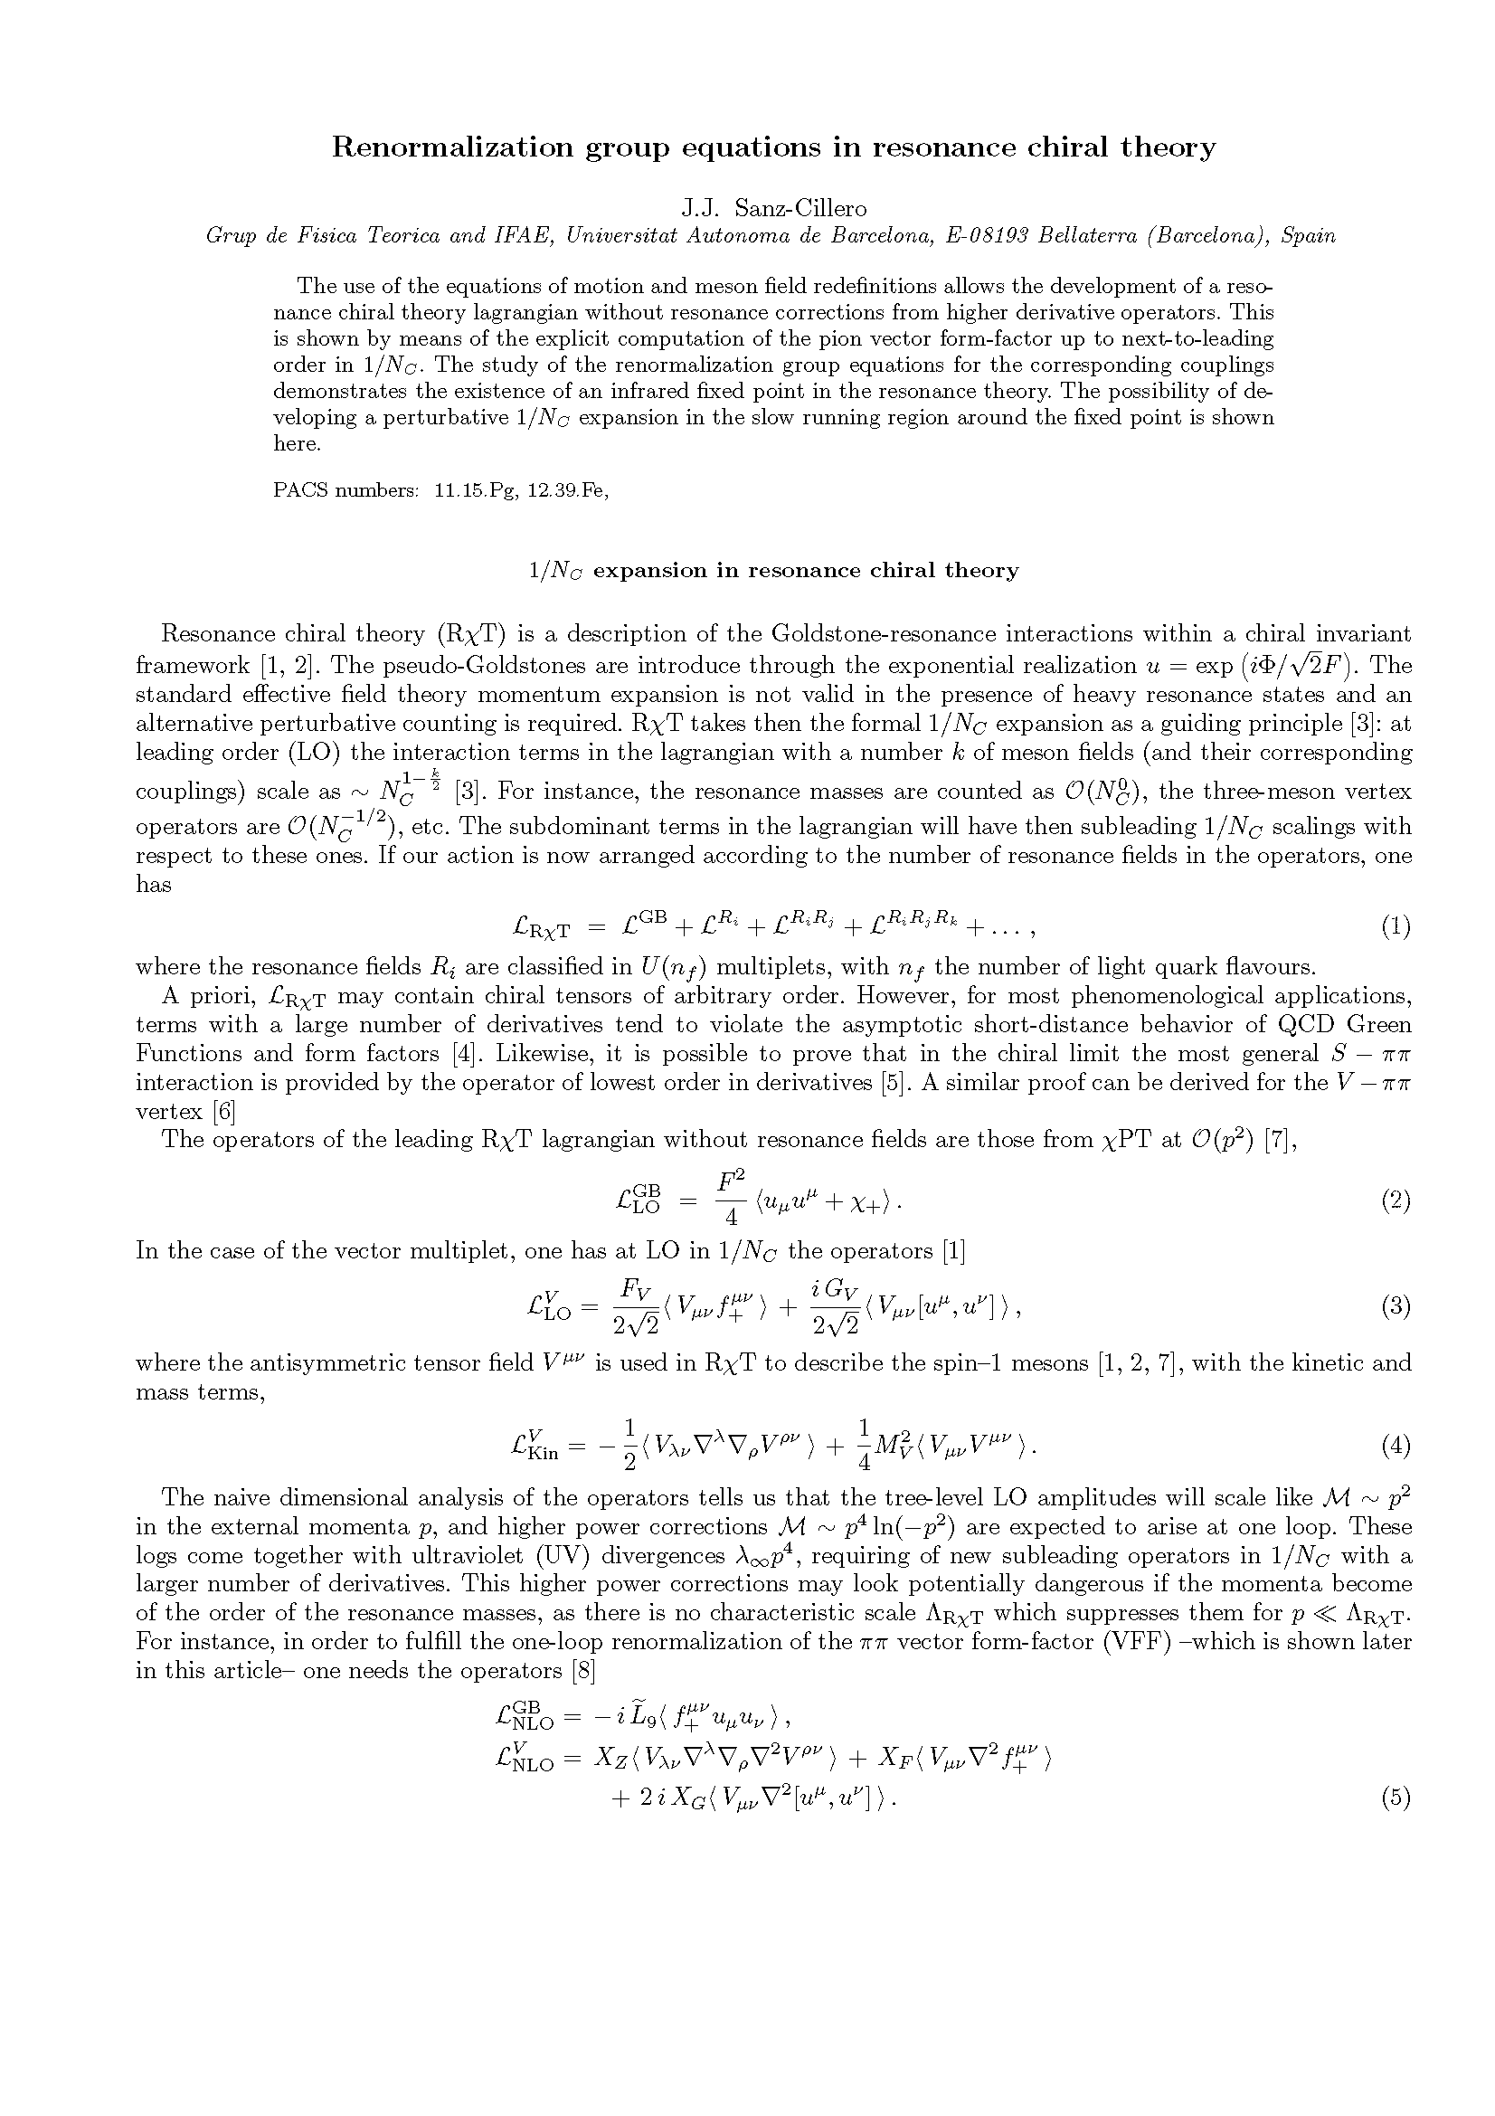
For practical purposes, the mesonic lagrangian can be organised in the form
Usually, the operators are built with the lowest number of derivatives as
- operators with more derivatives tend to violate
the asymptotic high-energy behaviour
prescribed by QCD for Green-fuctions and form-factors
- in some cases, higher derivative operators
can be removed by means of the EoM (field redefinitions)
[Ecker et al.’89]
[Rosell, Pich, SC’04]
[Xiao & SC’08]

Slide 6
At LO in 1/N_{C} (large N_{C}):
The operators with only Goldstones (no Resonance) are those from χPT:
In the case of the vectors (in the antisymmetric tensor form.),
with the canonical free-field kinetic term given by
[Gasser & Leutwyler’84,85]
[Ecker et al.’89]
[Ecker et al.’89]
[Gasser & Leutwyler’84]
[Ecker et al.’89]

Slide 7
At NLO in 1/N_{C} (loops + NLO tree-level):
[Rosell, Pich, SC’04]
[Ruiz-Femenía, Portoles, Rosell’07]
[Kampf, Novotny, Trnka’09]
…
The naive dimensional analysis tells us that
- The LO amplitude scales like M ~ p²
- The NLO one-loop amplitude → M ~ p⁴ ln(-p²)
➔UV-divergences M ~ λ∞ p⁴ (NLO in 1/N_{C})
➔O(p⁴) subleading operators to renormalize
E.g. in the case of the ππ-VFF,
[Rosell, Pich & SC’04]

Slide 8
However, higher power corrections ( like e.g. M ~ p⁴ )
may look potentially dangerous if p² ~ M_{R}²
⬅ as there no characteristic scale Λ_{RχT}
that suppresses the NLO for p << Λ_{RχT}
A solution to this issue will be achieved
  by means of meson field redefinitions
  for the case of the ππ-VFF…

Slide 9
ππ−Vector Form Factor
Notes:
9

Slide 10
ππ−Vector Form Factor:
Basic definitions
and one-loop computation
Notes:
10

Slide 11
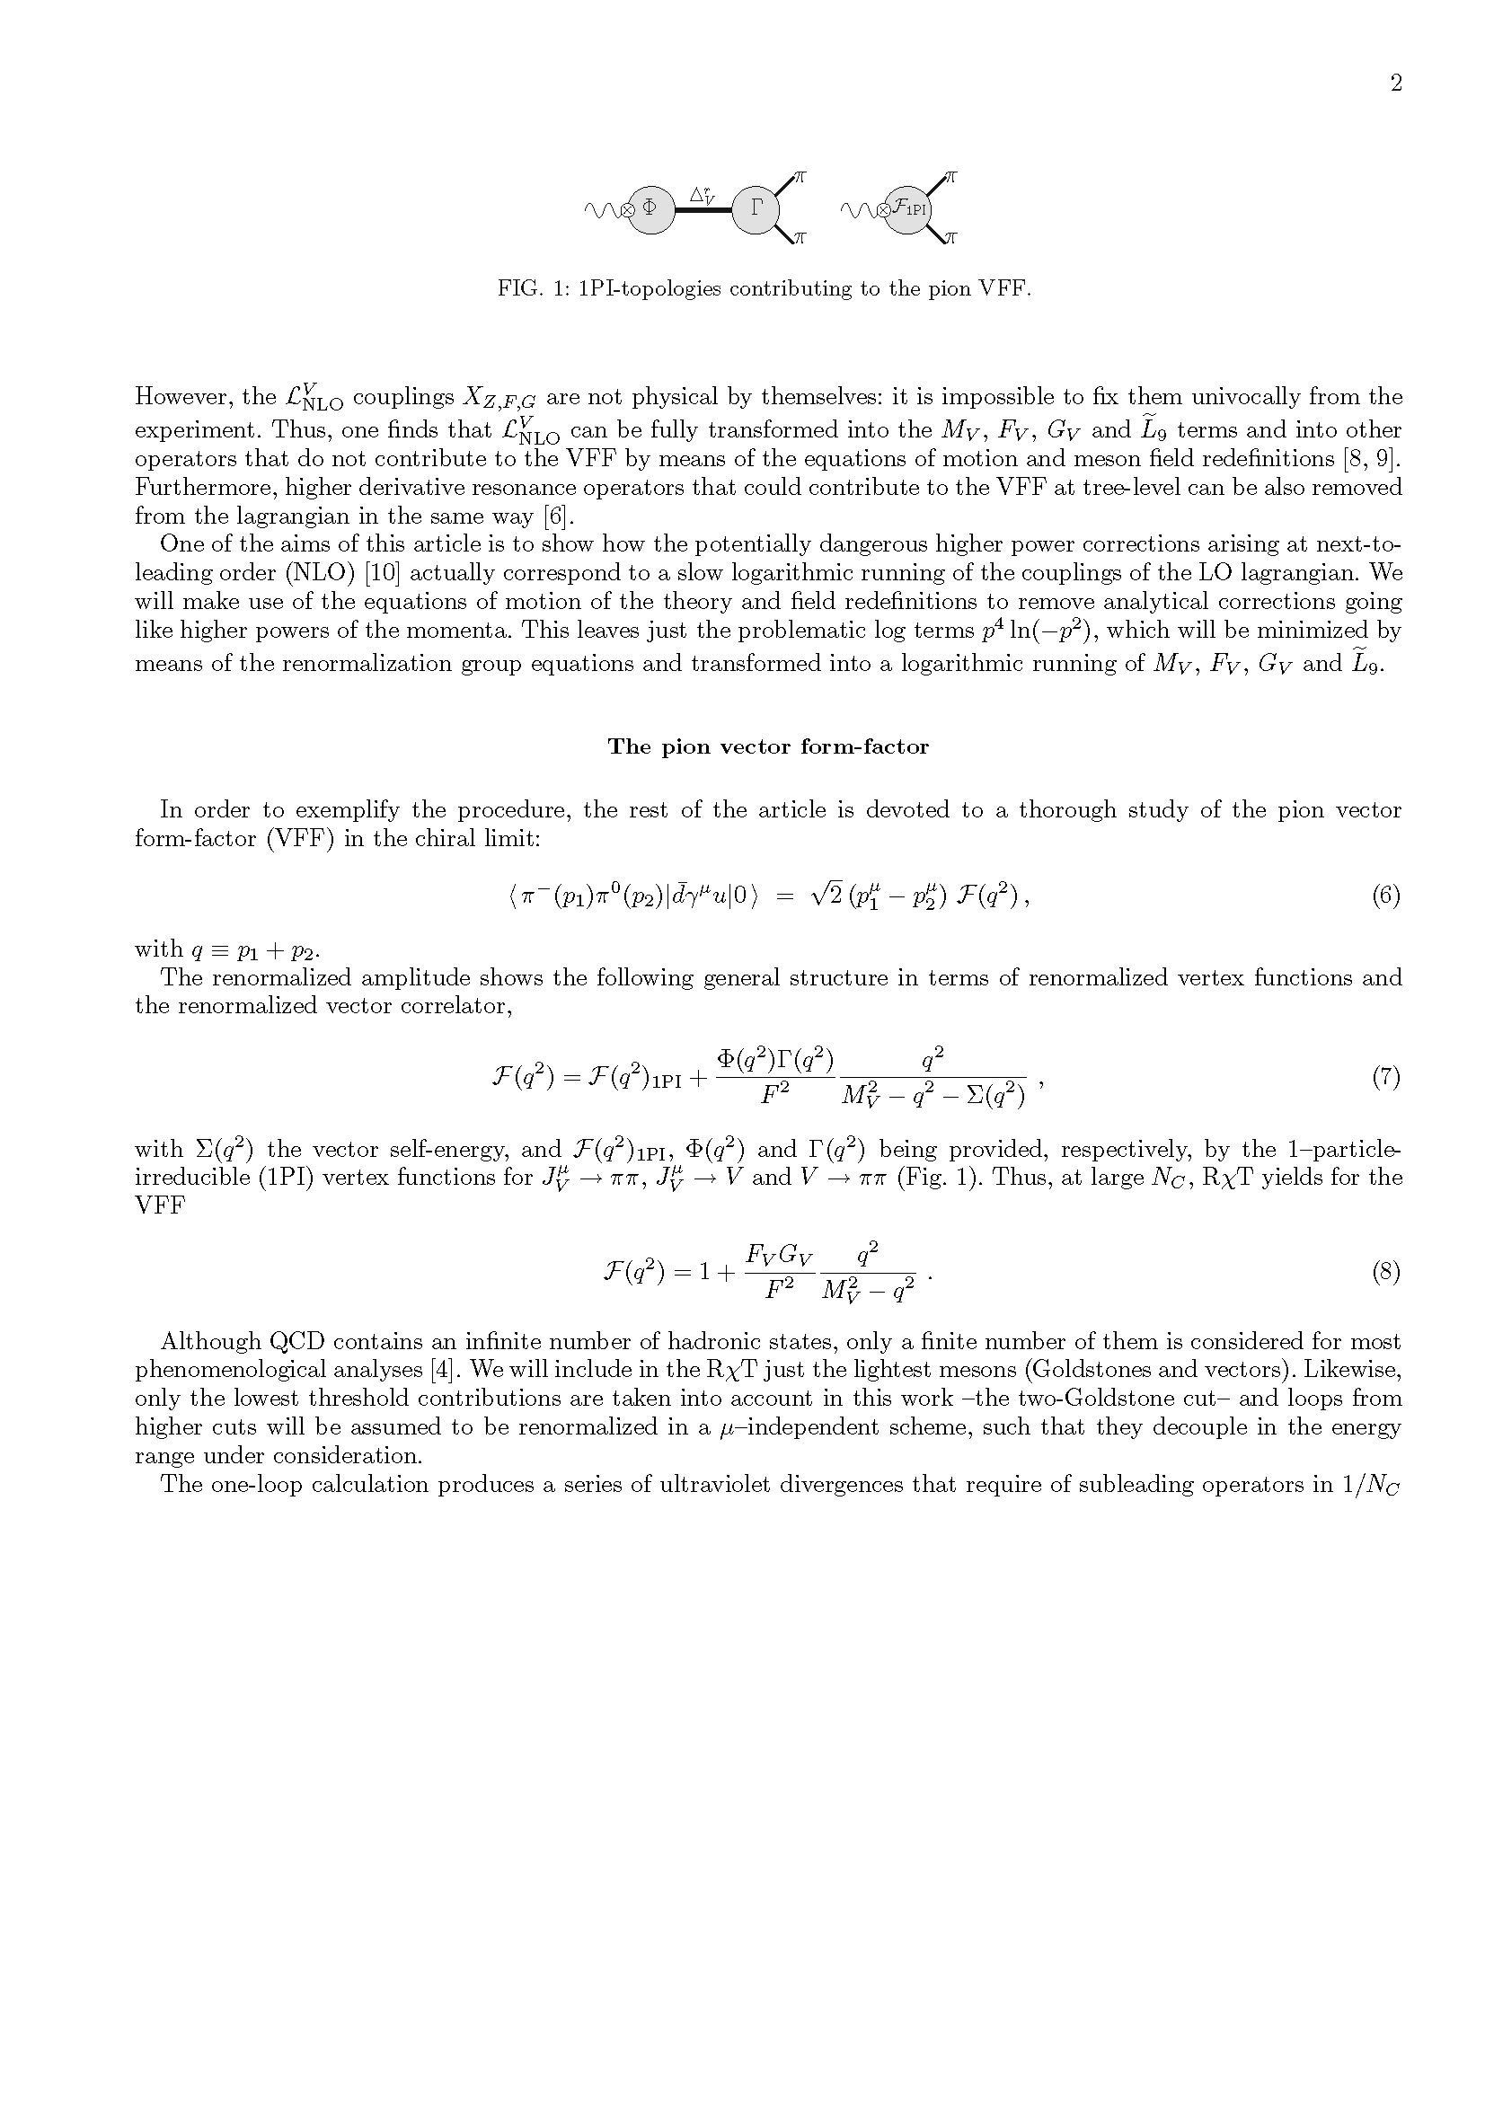
The ππ-VFF is defined by the scalar quantitys F(q²),
The VFF can be decomposed in 1PI contributions of the form
Example of the tree-level LO form factor

Slide 12
Assumptions:
    Truncation of the infinite number of large-N_{C} hadronic states
    Only up to O(p²) NGB operators at LO
+ only up to O(p⁴) NGB operators at NLO
(which can be justified under short-distance arguments)
    Just the lowest thresholds (ππ-cut) will be taken into account
(higher ones supposed to be renormalized in a decoupling scheme,
with their contribution supressed below their production threshold)

Slide 13
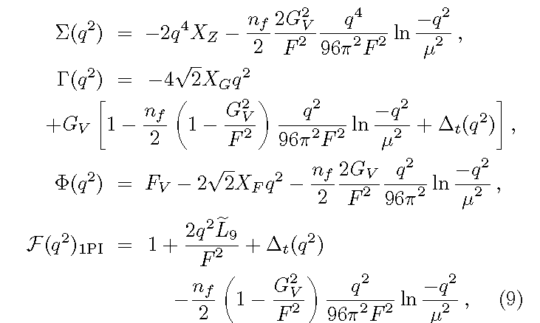
Explicit one-loop calculation → Loop contributions to the vertex functions,

Slide 14
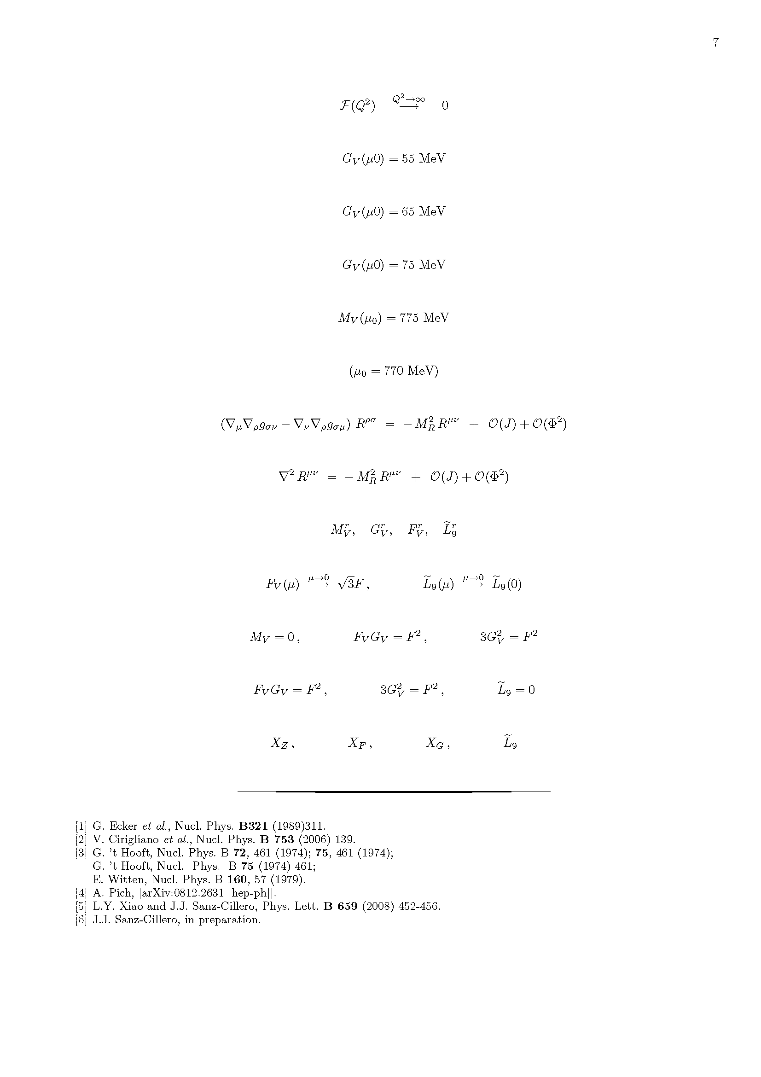
This requires the introduction of
to make the amplitude finite
→Here ( [Pich,Rosell, SC’04] [SC’09] ) the MS(+constant) scheme was used

Slide 15
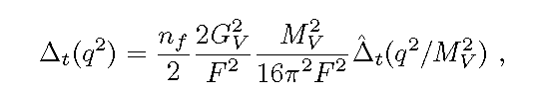
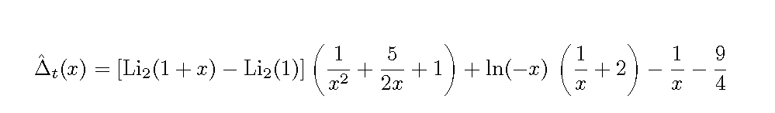
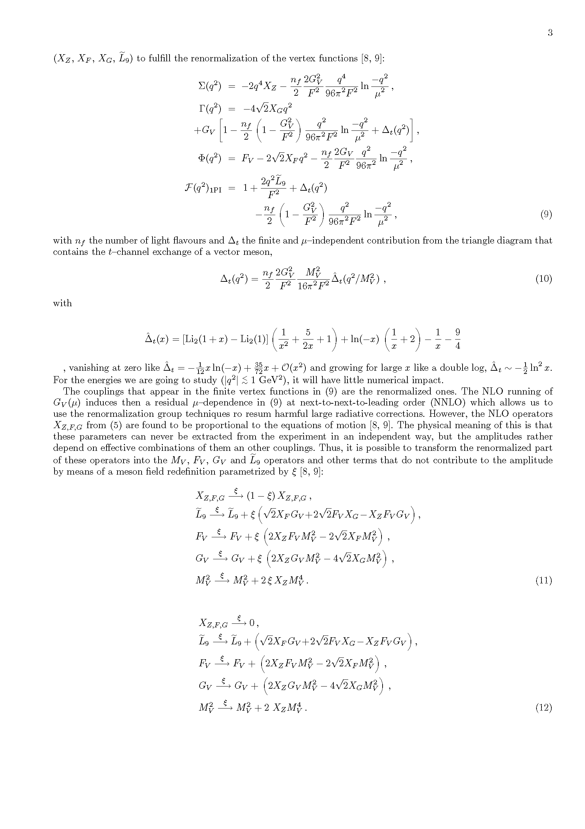
This leaves the renormalized vertex functions
[Rosell, Pich & SC’04]
with the finite triangle contribution,
x→0
being
x→∞

Slide 16
The couplings in the renormalized amplitudes
→Renormalized couplings
The NLO running in G_{V}(μ)
→induces a residual NNLO μ-dependence
This will allow us to use the RGE
  →to resum possible large radiative corrections

Slide 17
ππ−Vector Form Factor:
Field redefinitions
and redundant operators
Notes:
17

Slide 18
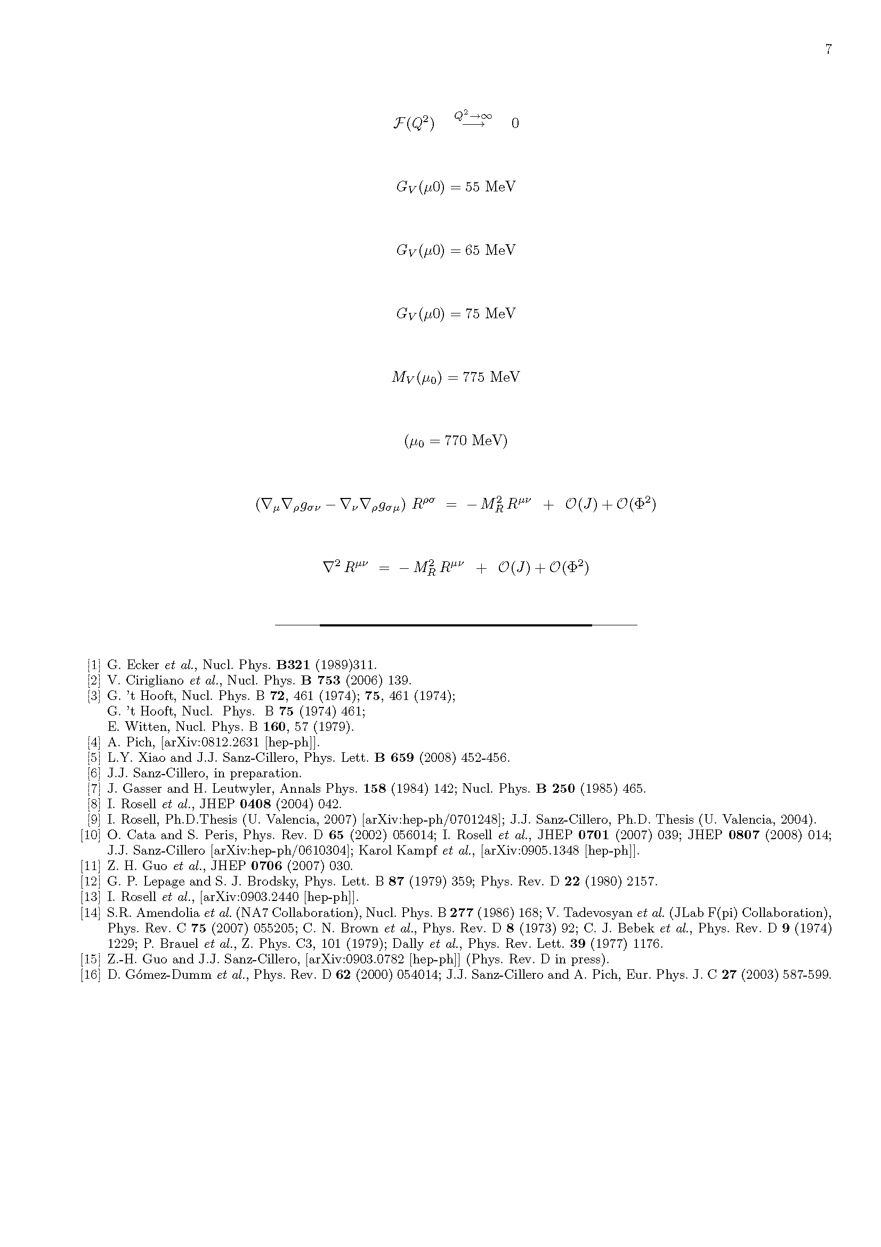
The L^{V}_{NLO} couplings are not physical by themselves
    →Impossible to fix the X_{Z,F,G} alone,
    →just combinations of them and other couplings
The reason is that they are proportional to the EoM,
and also obeying the KG equation,
[Rosell, Pich & SC’04]
at least
1 external source
at least
2 meson fields

Slide 19
The can be transformed by a vector field redefinition V→V+ξ
➔into other resonance operators with less derivatives: M_{V}, F_{V}, G_{V}
+ the operator
+ other operators that do not contribute to the ππ-VFF

Slide 20
Similarly, higher derivative L_{V} operators for the VFF can be simplified
Thus➔ the undesired O(p⁴) resonance operators (and their O(p⁴) contributions)
can be removed from the theory
We can remove the renormalized part of this operators through V→ V + ξ(X_{Z}^{r},X_{F}^{r},X_{G}^{r})
[Rosell, Pich & SC’04]

Slide 21
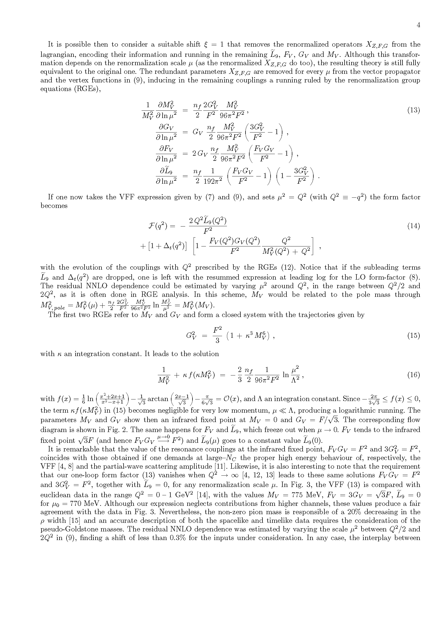
This field transformation:
    →removes X^{r}_{Z,F,G}
            →encodes their running into
Although the field redefinition ξ(X_{Z}^{r},X_{F}^{r},X_{G}^{r})
depends on the particular μ under consideration (since X^{r}_{Z,F,G} do),
the resulting theory is still equivalent to the original one
After removing X^{r}_{Z,F,G},
the remaining couplings are ruled by

Slide 22
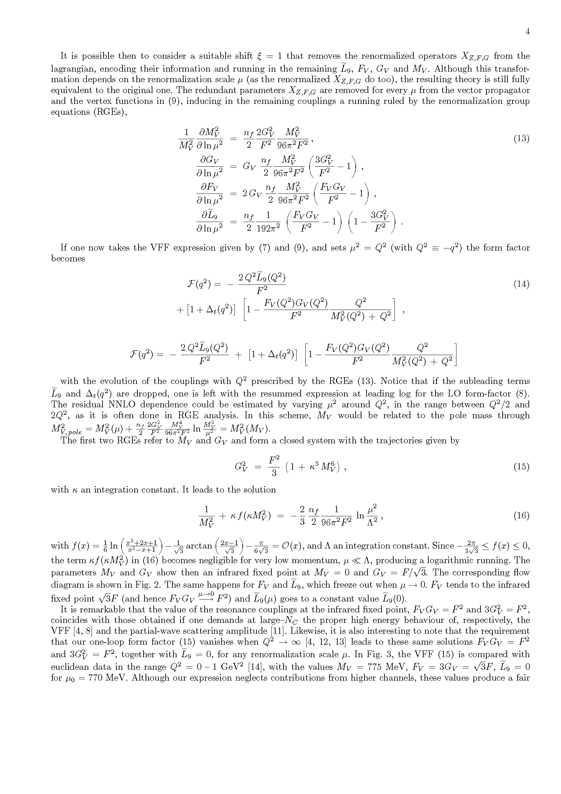
If now one sets the scale μ²= -q² (≡Q²) , the VFF takes the simple form
with the evolution of the amplitude with Q²
→provided by the evolution of the couplings (through the RGE)
For instace, the M_{V}(μ) would be related to the pole mass through

Slide 23
ππ−Vector Form Factor:
RGE solutions
Notes:
23

Slide 24
The RGE for M_{V} and G_{V} provide a close system of equations,
with solution of the form,
with the integration variables κ and Λ

Slide 25
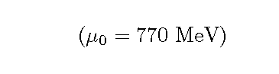
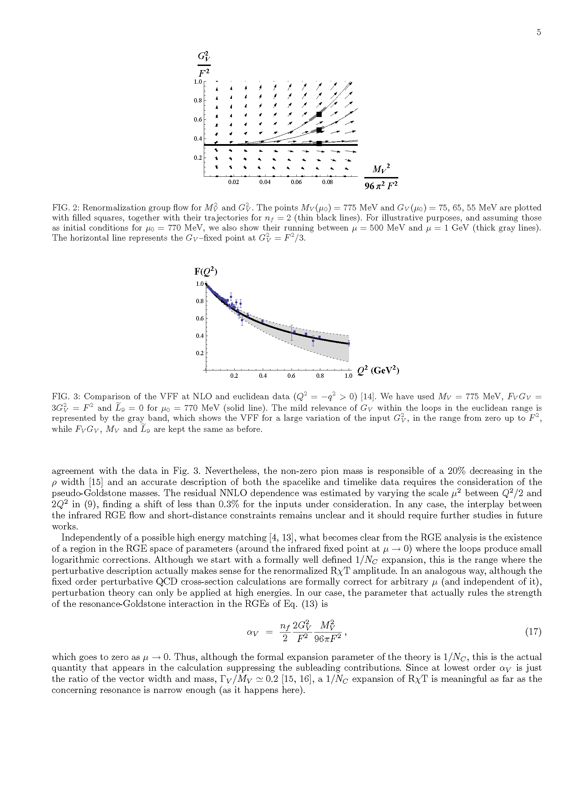

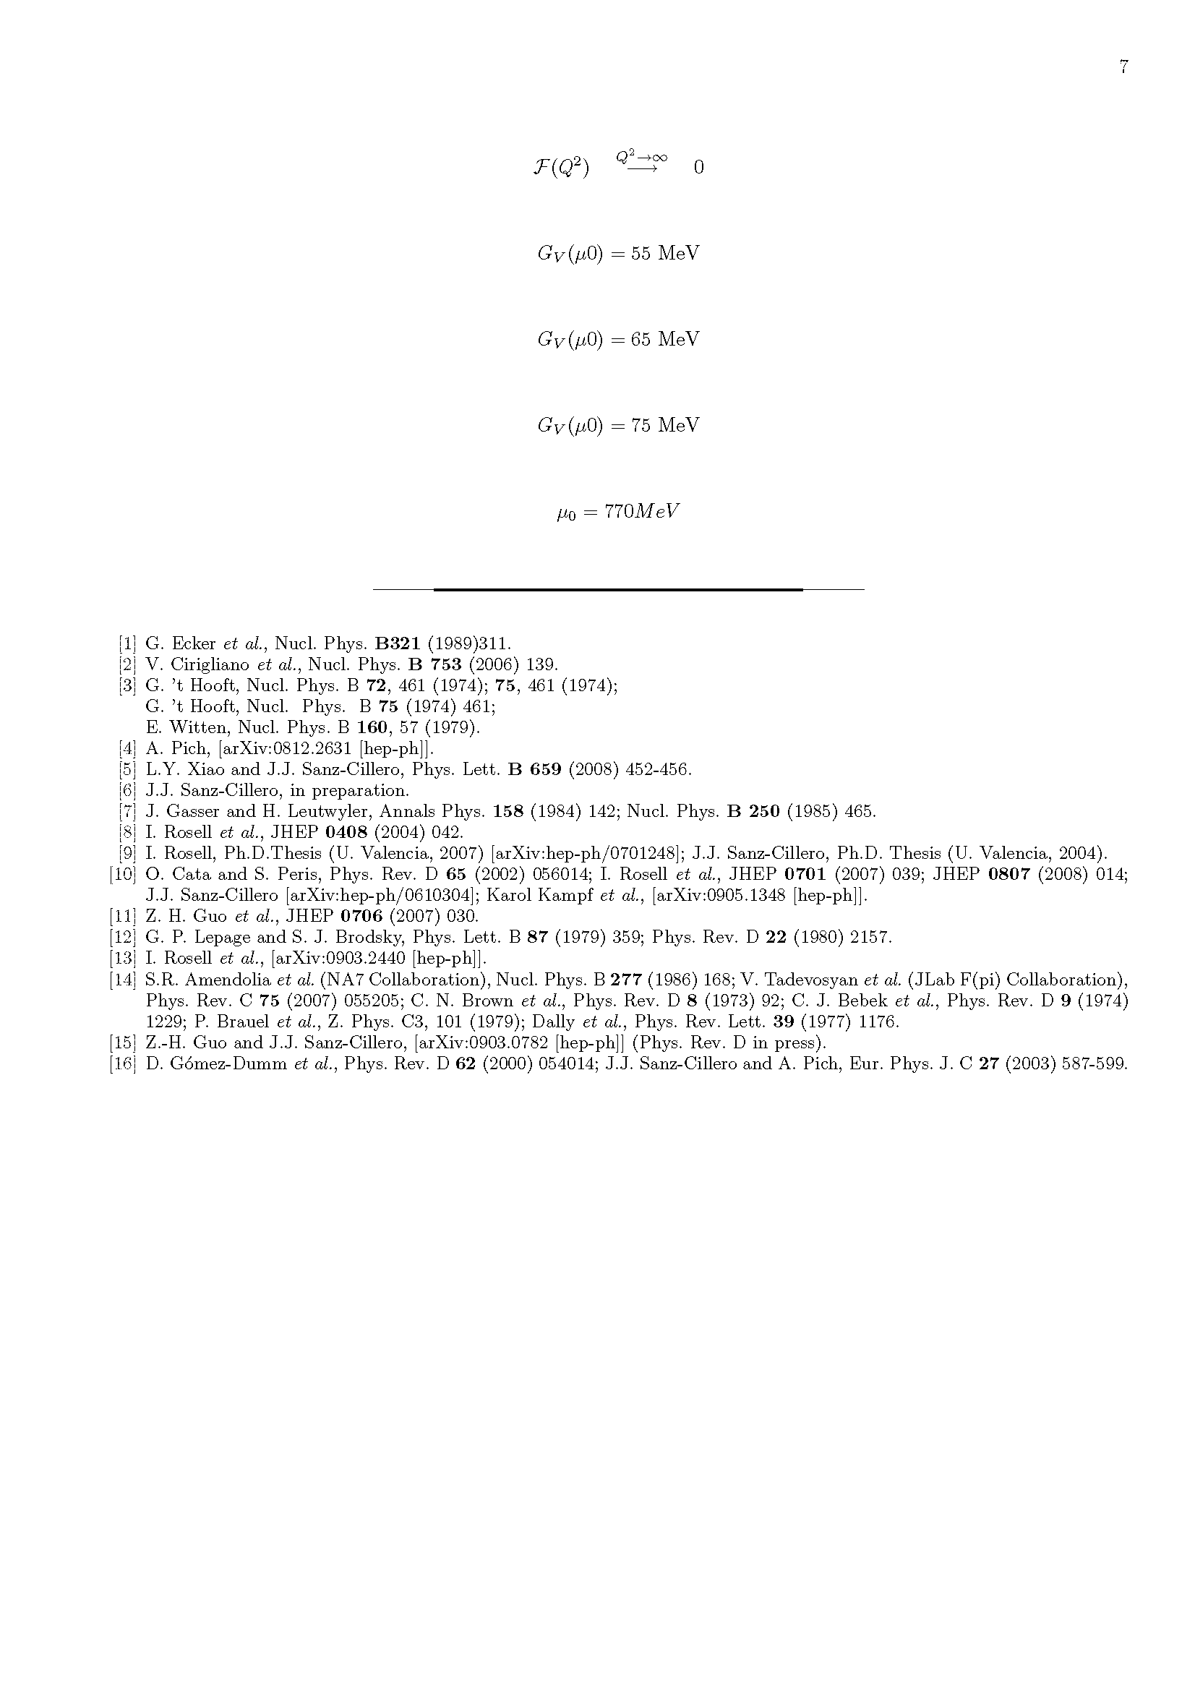
The RGE for M_{V} and G_{V} provide a close system of equations,
with solution of the form,
with the integration variables κ and Λ
This produces the flux diagram:

Slide 26
The RGE for M_{V} and G_{V} provide a close system of equations,
with solution of the form,
with the integration variables κ and Λ
This produces the flux diagram:

Slide 27
The RGE for M_{V} and G_{V} provide a close system of equations,
with solution of the form,
with the integration variables κ and Λ
This produces the flux diagram:
There appears an IR fixed point
  at M_{V}=0, 3G_{V}²=F²
where all the trajectories converge

Slide 28
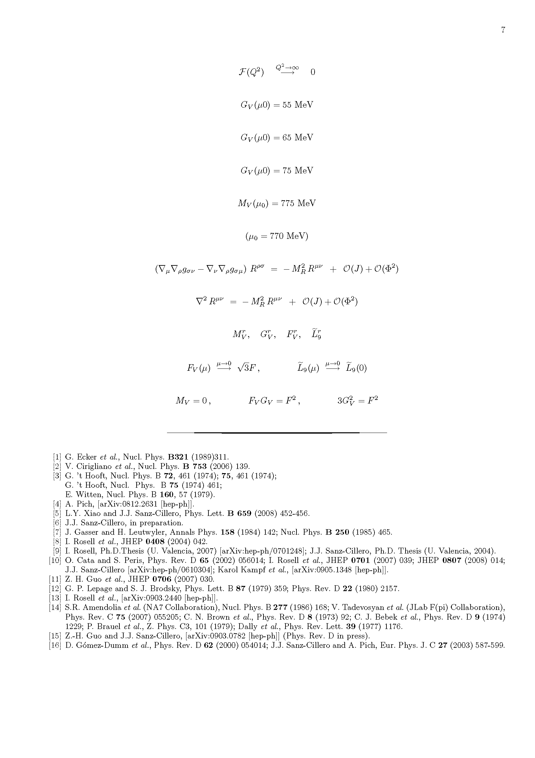
The same happens for the remaining couplings, which freeze out at μ→0
  →For any initial condition,
  the vector parameters have always the same IR fixed point (μ→0),
  → is the only one that depends on the μ=0 condition
The theory evolves then
→from the IR fixed-point in the χPT domain,
→up to higher energies through the log running given by the RGE

Slide 29
Remarkable fact #1
It is remarkable that
the values for the F_{V} and G_{V} IR-fixed points
agree with those obtained at large-N_{C}
  after demanding the right behaviour at Q²→∞ :
  -For the ππ-VFF → F_{V} G_{V} =F²
  -For the ππ-partial wave scattering → 3 G_{V}² = F²
[Ecker et al.’89]
[Guo, Zheng & SC’07]

Slide 30
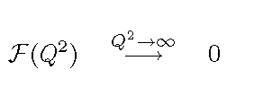

Remarkable fact #2
Likewise, it is also interesting that the requirement
for the resummed VFF,
leads to the same values as those from the IR-fixed point,
and, in addition,
for all μ (being μ−independent and with their running frozen out)

Slide 31
The agreement of the resummed VFF and data is fairly good.
Thus, for the inputs
G_{V}(μ₀)²=0 (same other inputs)
G_{V}(μ₀)²=F² (same other inputs)
However,
→The non-zero π mass is responsible for a 20% decreasing of the ρ-width
→An accurate description of both space-like/time-like data
needs the consideration of the pNGB masses
[Guo & SC’09]

Slide 32
ππ−Vector Form Factor:
Perturbative regime
Notes:
32

Slide 33
Independently of possible high-energy matching,
the RGE show the existence of a region in the space of parameters
(close enough to the IR-fixed point at μ→0)
→where the loop corrections are small
→and one has a slow logarithmic running
This fills of physical meaning the formal 1/N_{C} expansion
based on the formal N_{C} scaling of the lagrangian operators
→The theory can be described perturbatively as far as one
is close enough to the fixed point
ANALOGY:
    A fixed order QCD calculation is formally valid for any μ
    (and independent of it)
    RGE → perturbation theory only valid for large μ

Slide 34
In our case, the parameter that actually rules
the strength of the Resonance-Goldstone interaction
in the RGE is
This parameter goes to 0 when μ→0
→Around the IR-fixed point (μ→0) the couplings vary slowly
Thus, →Although the formal expansion is 1/N_{C}
    →α_{V} is the actual quantity suppressing subleading contributions
Since at LO α_{V} ≈ Γ_{V}/M_{V} ≈ 0.2 for μ ≈M_{V},
the 1/N_{C} expansion meaningful in the resonance region
as far as it is narrow enough (as it is the case)

Slide 35
Nevertheless,
  - In case of broad states,
  - or more complicate processes,
→Less intuitive identification
of the parameter that characterizes
the strength of the interaction
However, Perturbation Theory will make sense
→as far as we are able to find a momentum region where
- This parameter becomes small
- One has a slow running of the couplings

Slide 36
Conclusions
Notes:
36

Slide 37
A priori, higher derivative operators needed for 1 loop renormalization
→However, there are redundant operators
(which can be removed through meson field redefinitions)
RGE→existence of an IR-fixed point
+ slow log running in the region around μ→0
where α_{V} is small enough
This is where a perturbative expansion in 1/N_{C} makes sense:
Amplitude given by the RGE evolution of the couplings
from the IR-fixed point at 0 up to Q²
These considerations are expected to be relevant
      for other QCD matrix elements
      In particular, for Scalars (where width and corrections are large)
          e.g., the scalar form-factor
Notes:
37

